Slide 1

TOC- Capstone Project Title
Name: Saravanan k
Register No.:192210710
Year:2nd year
Department:CSE
Institution:SIMATS

Slide 2
Introduction:
In today's world flooded with text, it's crucial for computers to understand what people are talking about. This is where Natural Language Processing (NLP) comes in. One key task in NLP is figuring out the main topic or subject of a piece of text.
Imagine you're searching for news on a website. The website needs to quickly identify what each article is about so it can organize them for you. That's where topic identification becomes important.
There are different ways computers can do this, from simple methods like picking out important words, to more complex methods like using artificial intelligence to understand context.
here, we'll explore the different methods computers use to identify topics in text. By understanding these methods, we can appreciate how computers organize and make sense of the vast amounts of information available online.

Slide 3
Rationale and Relevance:
Efficient Information Retrieval: Helps search engines and recommendation systems find relevant content quickly.
Content Summarization: Creates concise summaries of long texts for easier understanding.
Personalized Recommendations: Powers systems that suggest tailored content based on individual interests.
Understanding Opinions: Analyzes sentiments and opinions in reviews and social media.
Sorting Documents: Organizes large amounts of text into meaningful groups for easier management.
Spotting Trends: Assists businesses in identifying emerging trends and staying competitive.
Research Insights: Enables researchers to analyze academic papers and discover new knowledge.
Improving Language Tools: Enhances translation and text generation tools for better

Slide 4
Abstract:
Topic identification is a fundamental task in Natural Language Processing (NLP), allowing computers to understand and categorize text. This abstract highlights the importance of topic identification in applications like information retrieval and content summarization. By analyzing its role in tasks such as search, sentiment analysis, and trend spotting, we reveal how topic identification improves human-computer interaction and knowledge discovery. Understanding its significance opens up opportunities to make use of NLP for better navigation of textual data

Slide 5
Objectives of the Project:
The objectives of the project is to improving efficiency in information retrieval, enhancing content summarization
Applications of the Project:
The project's applications span various domains, including search engines, content summarization tools, recommendation systems, sentiment analysis platforms, document management systems, market intelligence software, academic research tools, and language understanding applications, showcasing its versatility and impact.

Slide 6
Procedures and Methodology:
Collecting diverse textual data.
Preprocessing data for analysis.
Extracting relevant features.
Applying topic identification algorithms.
Evaluating algorithm performance.
Integrating algorithms into applications.
Validating results through testing.
Iteratively refining methodologies for accuracy and efficiency.

Slide 7
Project Requirements
Hardware Requirements:
Computing Devices
Memory (RAM)
Storage Space
Processor (CPU)
Graphics Processing Unit (GPU) [Optional]
Software Requirements:
Development Environment (IDE or text editor)
Programming Languages (e.g., Python)
Data Processing Tools (e.g., Pandas, NumPy)
Topic Identification Libraries (e.g., Gensim, sklearn, TensorFlow)
Evaluation Tools (e.g., Matplotlib, seaborn)
Version Control System (e.g., Git)
Documentation Tools (e.g., Markdown, LaTeX)
Project Management Tools (e.g., Trello, Asana, Jira)
Deployment Environment (if applicable)

Slide 8
Research and Analysis:

Slide 9
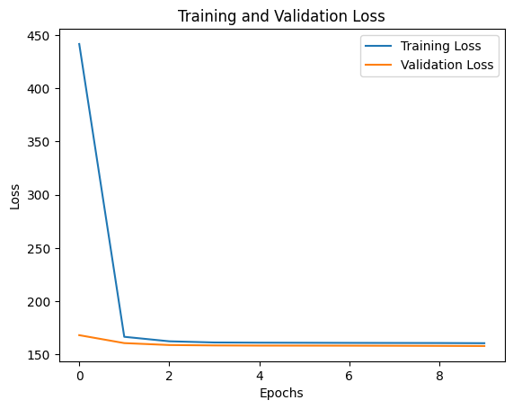
Evaluation of Outcomes/Results and Findings:
Epochs: An epoch is one complete pass through the entire training dataset. During each epoch, the model is trained on the entire dataset in batches.
Loss: In the context of machine learning, loss is a measure of how well the model's predictions match the actual target values (labels) in the training data.

Slide 10
Conclusion and Future Work/Suggestions:
The project has successfully developed models for topic identification in NLP, achieving objectives such as enhancing information retrieval and content summarization.
Future Work/Suggestions:
Fine-tuning models with larger datasets.
Exploring advanced algorithms like hierarchical topic modeling.
Integrating models into real-world applications.
Optimizing scalability and efficiency.
Investigating multimodal topic identification.
Incorporating user feedback for improvements.
Addressing ethical considerations.
Contributing to open-source initiatives for collaboration.

Slide 11
Bibliography:
Blei, D. M., Ng, A. Y., & Jordan, M. I. (2003). Latent Dirichlet Allocation. Journal of Machine Learning Research, 3(Jan), 993–1022.
Blei, D. M., & Lafferty, J. D. (2007). A correlated topic model of Science. The Annals of Applied Statistics, 1(1), 17-35.
Griffiths, T. L., & Steyvers, M. (2004). Finding scientific topics. Proceedings of the National Academy of Sciences, 101(suppl 1), 5228-5235.
Hoffman, M. D., Blei, D. M., Wang, C., & Paisley, J. (2013). Stochastic variational inference. Journal of Machine Learning Research, 14(1), 1303-1347.
Liu, H., Yang, C., Zhang, A., & Ji, S. (2016). Multi-view clustering via joint nonnegative matrix tri-factorization. Neurocomputing, 173, 1633-1643.

Slide 12
Appendix:

